Slide 1


Software Quality Engineering (Week-1)
Usama Musharaf
LECTURER (Department of Computer Science)
FAST-NUCES Peshawar

Slide 2
Course Content
Software Quality, Software Quality Attributes, Quality Engineering., Testing: Concepts, Issues, and Techniques, Software testing lifecycle., Testing Scopes., Testing Approaches., Testing Concepts., Test Planning Process, Introduction to testing process, Requirement of software test planning, Testing documentation, Reporting and historical data recording., Software testing techniques, Testing philosophies , Testing strategies, Model based testing, Software testing techniques, Testing using models, Domain and combinatorial testing, Unit and integration testing, Acceptance testing, Test automation, Slicing, Software reliability models and engineering, Introduction, Exponential model., Reliability growth models, Modeling process, Software inspections, Software reviews, Inspection checks and metrics, Quality Models, Models for quality assessment, Product quality metrics, Quality Measurements, In-Process metrics for software testing, In-Process quality management, Effort/outcome models, System testing, Introduction to sub-system testing, From functional to system aspects of testing, System testing, Introduction to system testing, Scenarios development, System testing, Use-cases for testing, Specification-based testing, Open issues on software testing.

Slide 3
Recommended Books
Paul Jorgensen, Software Testing, A Craftsman's Approach, 4th Ed. CRC Press, Taylor and Francis Group, 2015
Bernard Homes, Fundamentals of Software Testing, ISTE, Wiley, 2012
Software Engineering, “Ian Sommerville, 9th Edition, Addison Wesley, 2011

Slide 4
Evaluation Criteria
Assessment | Weightage
Assignment | 10%
Quiz | 10%
Sessional 1 | 15%
Sessional 2 | 15%
Final Exam | 50%

Slide 5
Weekly Plan
Week | Topics
Week 1 - 2 | Intro to Software Quality Engineering, Quality Engineering Road Map, Quality Engineering Economics Quality Engineering at Requirement Phase, Requirement Document Template. Agile Development (Scrum), DevOps overview,
Week- 3 – 5 | Quality Engineering at Architecture Phase Quality Models, Quality attributes (Performance, Scalability, Reliability, Security) Quality Engineering at Design Phase Design Principles and Patterns
Week- 6 – 12 | Quality Engineering at Code Phase Software Configuration Management, Version Control System, GIT, GIT Hub, Software Testing, Black Box, White Box, Software Testing with JUNIT framework. Control Flow Testing, Data Flow Testing, Functional Testing, Test generation from FSM models.

Slide 6
Weekly Plan
Week | Topics
Week 13 – 15 | Quality Engineering at Deployment Phase Issues in the deployment of large scale software systems Software Deployment Technology Stack (Deployment with virtual machines, containers, … Containerizing an application from scratch, Deployment on cloud. CI/CD pipeline.

Slide 7
Content of Week # 1
Introduction to Software Quality Engineering
Quality Engineering Road Map
Quality Engineering Economics

Slide 8
What is Software Quality ?
According to the IEEE
Software quality is:
The degree to which a system, component, or process meets specified requirements.
The degree to which a system, component, or process meets customer or user needs or expectations.

Slide 9
What is Software Quality?
“Achieving high levels of user satisfaction, portability, maintainability, robustness, and fitness for use” by Dr. Barry Boehm.
Quality means “conformance to user requirements” by Phil Crosby.
Edwards Deming considers quality to be “striving for excellence” in reliability and functions by continuous improvement in the process of development, support by statistical analysis of the causes of failure.

Slide 10
What is Software Quality?
Watts Humphrey, of the SEI, tends to speak of quality as “achieving excellent levels of fitness for use, conformance to requirements, reliability and maintainability.”
James Martin said that software quality means being on time, within budget and meeting user needs.
Tom McCabe, the software complexity specialist, defines quality as “high level of user satisfaction and low defect levels, often associated with low complexity.

Slide 11
What is Software Quality?
John Musa of Bell Laboratories states that quality means combination of “low defect levels, adherence of software functions to users needs, and high reliability”
Bill Perry, head of Quality Assurance Institute has defined quality as “high levels of user satisfaction and adherence to requirements”.

Slide 12
Importance of Software Quality
Software is a major component of computer systems
(about 80% of the cost)
– used for
– communication (e.g. phone system, email system)
– health monitoring,
– transportation (e.g. automobile, aeronautics),
– economic exchanges (e.g. ecommerce),
– entertainment,
– etc.
Software defects are extremely costly in term of
– money
– reputation
– loss of life

Slide 13
What is Software Quality Assurance?
According to the IEEE
Software quality assurance is:
A planned and systematic pattern of all actions necessary to provide adequate confidence that an item or product conforms to established technical requirements.
A set of activities designed to evaluate the process by which the products are developed or manufactured. Contrast with: quality control.

Slide 14
What is Software Quality Assurance?
According to D. Galin
Software quality assurance is:
“A systematic, planned set of actions necessary to provide adequate confidence that the software development process or the maintenance process of a software system product conforms to established functional technical requirements as well as with the managerial requirements of keeping the schedule and operating within the budgetary confines.”

Slide 15
Software Quality Challenges
Quality cannot be directly checked in the product; it must planned right from the beginning.
The project must focus on the quality issues of the project from the beginning, ensuring that quality criteria are consistent with defined requirements.
Quality means meeting requirements and meeting customer needs, which means a defect-free product from both the producer’s and the customer’s viewpoint.

Slide 16
Software Quality Engineering Road Map
Quality Engineering at every SDLC phase:
Quality Engineering
Requirement Analysis
Quality Attributes
Design
Version Controlling
GIT, GIT Hub
Code
Unit Testing
(JUnit)
Testing
Docker Containers
Defects
Deployment

Slide 17
What is an Error?
Error is usually refer to some syntax mistake by developer.
Refer to both Syntax and semantic error.
Syntax error are usually fixed by developer.
Semantic error give rise to unusual output.

Slide 18
What is Defect?
Defect is deviation from customer requirement.
Mostly defects are found in the software after software is shipped to the customer at production site.
Example:
In online shopping, the option of searching a debit card for making payment is missing.

Slide 19
What is Bug?
Error found before the software is shipped into production.
“Defects” accepted by developers are bugs.

Slide 20
What is Fault?
Fault is a result of error.
Fault is an incorrect step or process due to which unanticipated result arises.

Slide 21
What is Failure?
Failure is a result of faults.
Failure is inability of the program to behave as expected within given performance requirement.

Slide 22
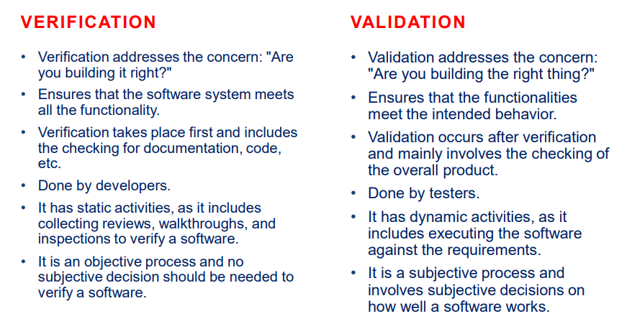

Slide 23
Quality Engineering Economics
High concerns and challenges in the software quality engineering, one must realize the following facts in order to cope with the quality task:
Everything in the process of software development ends up in the user’s satisfaction.
Satisfaction of the user is dependent on the overall behavior of the system.
Features and quality of the software product are defined/determined through requirements.

Slide 24
Function Quality Cost (FQC)
In most development projects, functionality and quality ( QA precisely) are natural enemies.
Projects with open budgets are very rare, usually the budget is fixed and here the functionality and quality compete with each other in order to get a bigger share from budget.
The Function-Quality-Cost comes out to be
Cost = AF + BQ
Where A & B = Level of investment
F = Features/Functions
Q = Quality

Slide 25
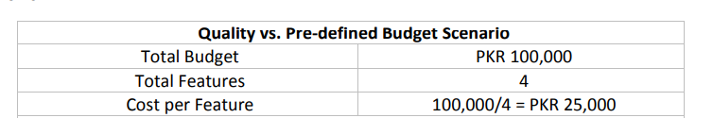
Function Quality Cost (FQC)
It is very much clear that increasing feature in a closed-budget project will certainly decrease the budget share for quality of the product.
The following example will elaborate the concept more clearly.
(Dev + QA)

Slide 26
HAVE A GOOD DAY !

